Slide 1
Unit4
TABLES & FRAMES

Slide 2
HTML Tables
HTML tables allow web developers to arrange data into rows and columns.
An HTML table is defined with the <table> tag.
Each table row is defined with the <tr> tag.
A table header is defined with the <th> tag.
By default, table headings are bold and centered.
A table data/cell is defined with the <td> tag.

Slide 3
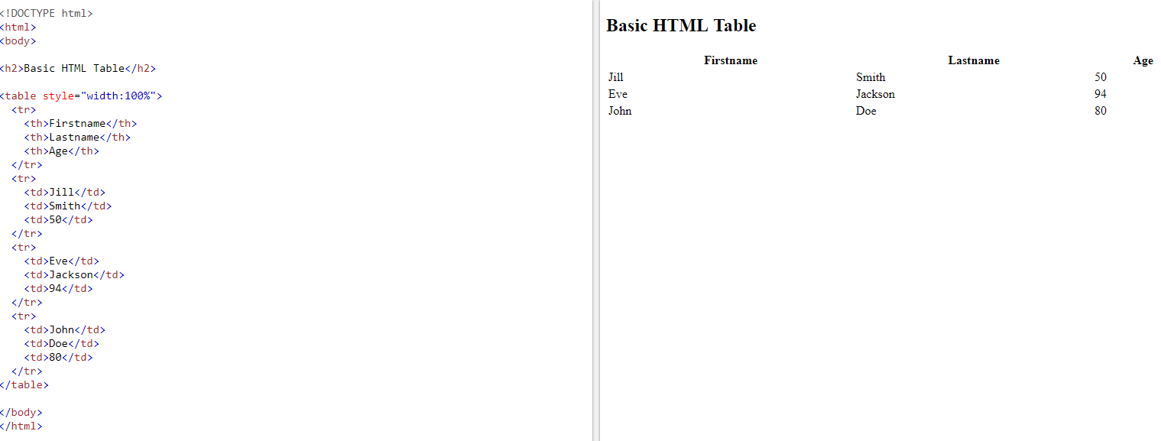
Table without border

Slide 4
Table with border:
<table border="1" style="width:100%">
<tr>
<th>Firstname</th>
<th>Lastname</th>
<th>Age</th>
</tr>
<tr>
<td>Jill</td>
<td>Smith</td>
<td>50</td>
</tr>
<tr>
<td>Eve</td>
<td>Jackson</td>
<td>94</td>
</tr>
<tr>
<td>John</td>
<td>Doe</td>
<td>80</td>
</tr>
</table>

Slide 5
Cells that Span Many Columns
To make a cell span more than one column, use the colspan attribute:
<table border=“1” style="width:100%">
<tr>
<th>Name</th>
<th colspan="2">Telephone</th>
</tr>
<tr>
<td>Bill Gates</td>
<td>55577854</td>
<td>55577855</td>
</tr>
</table>
Name | Telephone
Bill Gates | 55577854 | 55577855

Slide 6
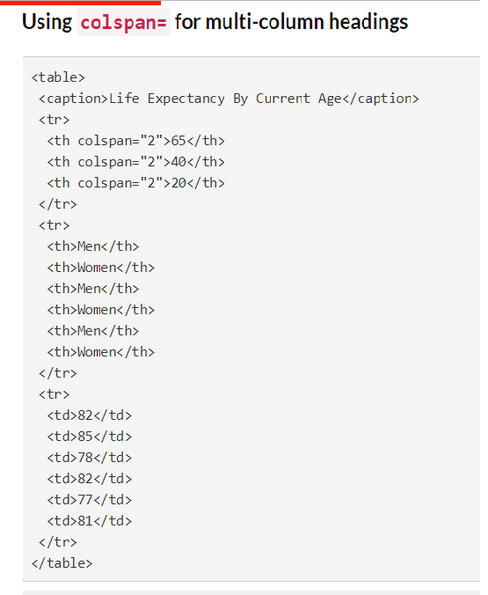
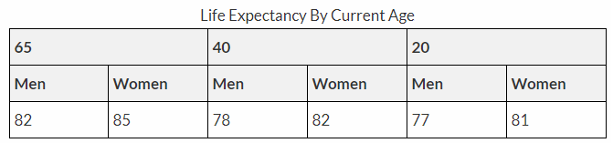
Cells that Span Many Columns

Slide 7
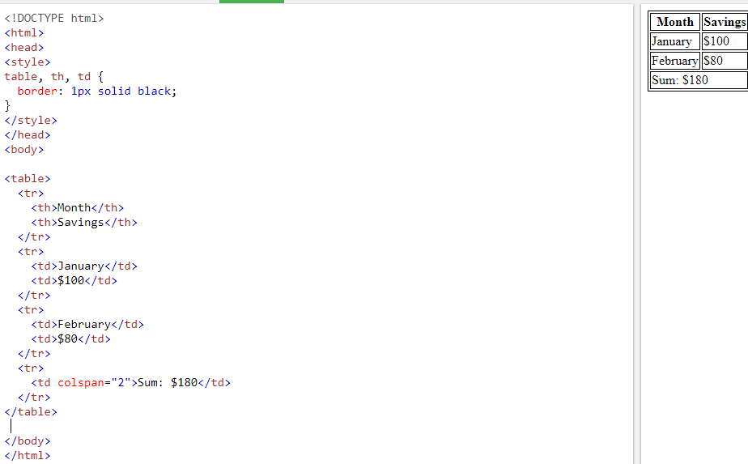

Slide 8
Cell that Spans Many Rows
To make a cell span more than one row, use the rowspan attribute:
<table style="width:100%">
<tr>
<th>Name:</th>
<td>Bill Gates</td>
</tr>
<tr>
<th rowspan="2">Telephone:</th>
<td>55577854</td>
</tr>
<tr>
<td>55577855</td>
</tr>
</table>
Name: | Bill Gates
Telephone: | 55577854
 | 55577855

Slide 9
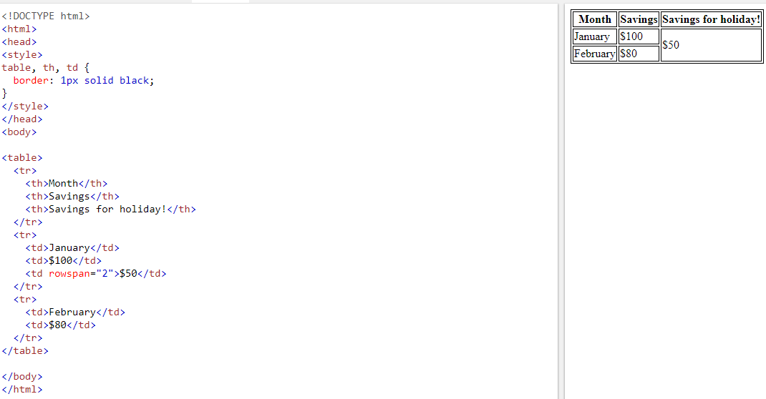
HTML <td> rowspan Attribute
The rowspan attribute specifies the number of rows a cell should span.

Slide 10
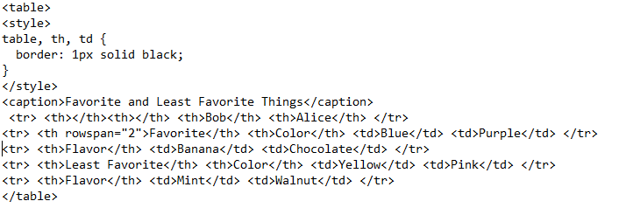
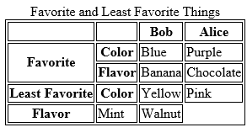

Slide 11
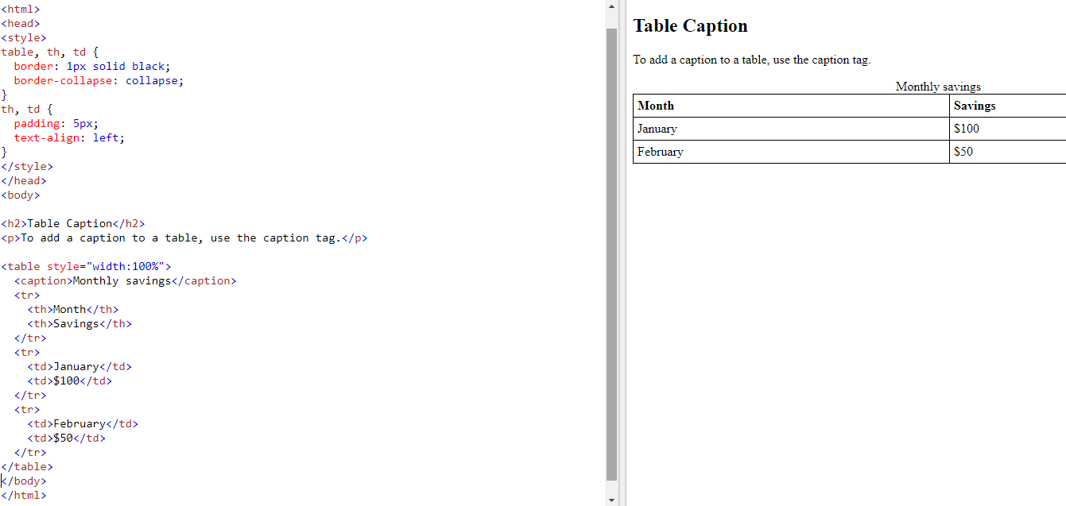
Adding a Caption

Slide 12
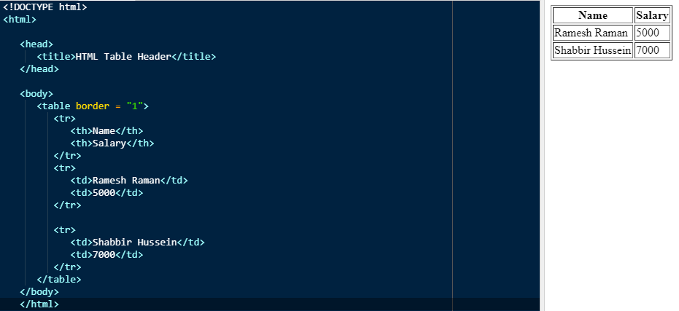
Here, the border is an attribute of <table> tag and it is used to put a border across all the cells. If we do not need a border, then we can use border = "0".

Slide 13
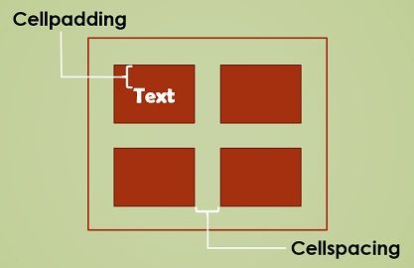
Cellpadding and Cellspacing Attributes
There are two attributes called cellpadding and cellspacing which we will use to adjust the white space in your table cells.
The cellspacing attribute defines space between table cells.
The Cellpadding represents the distance between cell borders and the content within a cell.

Slide 14
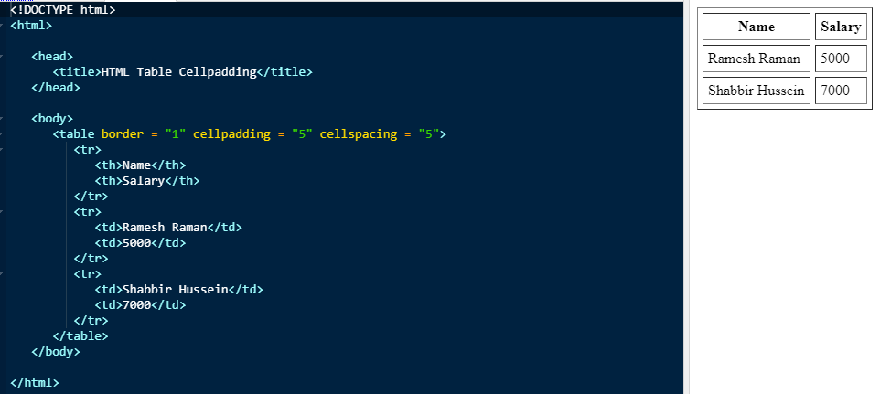

Slide 15
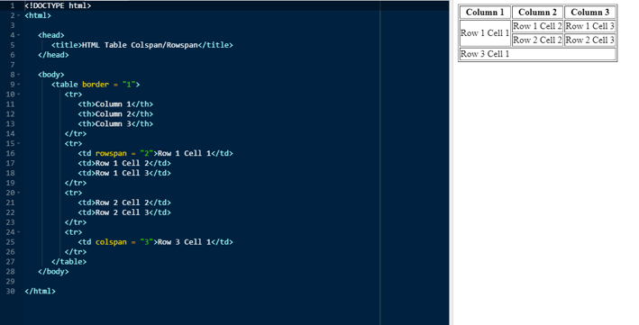

Slide 16
Tables Backgrounds
we can set table background using one of the following two ways −
bgcolor attribute − we can set background color for whole table or just for one cell.
background attribute − we can set background image for whole table or just for one cell.
we can also set border color also using bordercolor attribute.

Slide 17
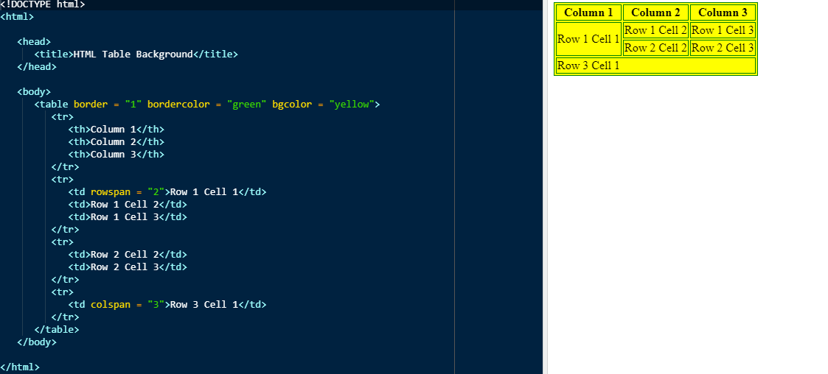

Slide 18
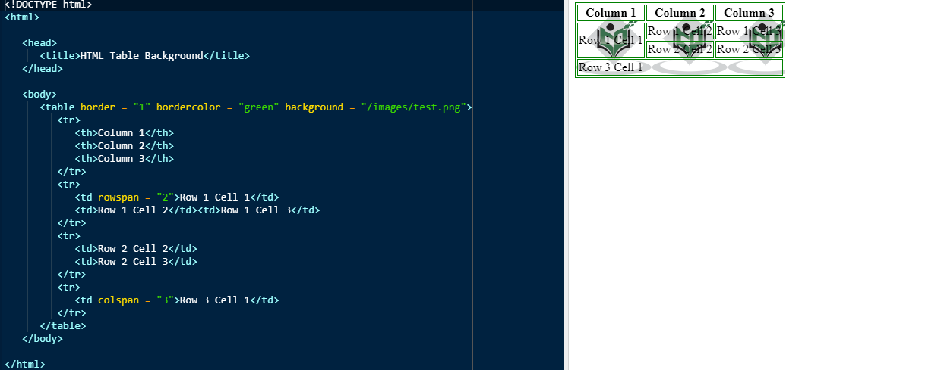

Slide 19
Table Height and Width
we can set a table width and height using width and height attributes.
we can specify table width or height in terms of pixels or in terms of percentage of available screen area.

Slide 20
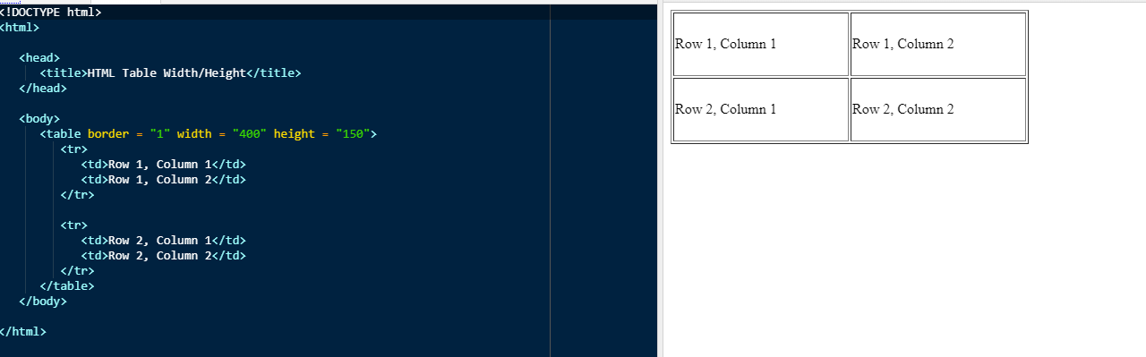

Slide 21
Table Header, Body, and Footer
Tables can be divided into three portions − a header, a body, and a foot. The head and foot are rather similar to headers and footers in a word-processed document that remain the same for every page, while the body is the main content holder of the table.
The three elements for separating the head, body, and foot of a table are :−
<thead> − to create a separate table header.
The <thead> tag is used to group header content in an HTML table.
<tbody> − to indicate the main body of the table.
The <tbody> tag is used to group the body content in an HTML table.
<tfoot> − to create a separate table footer.
The <tfoot> tag is used to group footer content in an HTML table.
Browsers can use these elements to enable scrolling of the table body independently of the header and footer. Also, when printing a large table that spans multiple pages, these elements can enable the table header and footer to be printed at the top and bottom of each page.

Slide 22
EXAMPLE:
<table> <thead> <tr> <th>Month</th> <th>Savings</th> </tr> </thead> <tbody> <tr> <td>January</td> <td>$100</td> </tr> <tr> <td>February</td> <td>$80</td> </tr> </tbody> <tfoot> <tr> <td>Sum</td> <td>$180</td> </tr> </tfoot> </table>
The thead, tbody, and tfoot elements
Month | Savings
January | $100
February | $80
Sum | $180

Slide 23
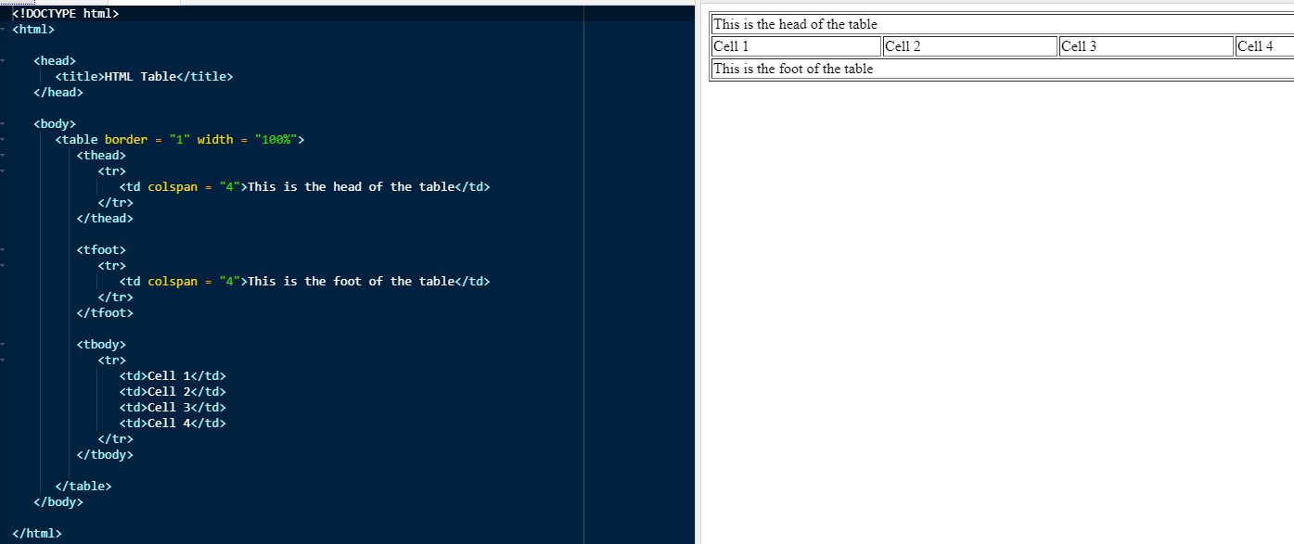

Slide 24
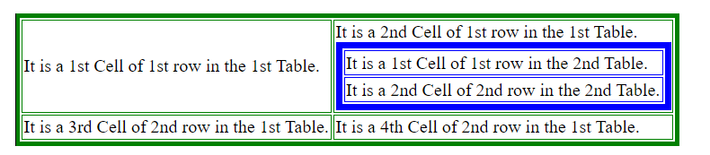
Nested Tables
The nested table in HTML means creating a table on a webpage inside another table on the same web page.
<Html>
<body>
<table border="4" bordercolor="green">
<tr>
<td> It is a 1st Cell of 1st row in the 1st Table. </td>
<td> It is a 2nd Cell of 1st row in the 1st Table.
<table border="6" bordercolor="blue">
<tr>
<td> It is a 1st Cell of 1st row in the 2nd Table. </td>
</tr>
<tr>
<td> It is a 2nd Cell of 2nd row in the 2nd Table. </td></tr>
</table>
</td>
</tr>
<tr>
<td> It is a 3rd Cell of 2nd row in the 1st Table. </td>
<td> It is a 4th Cell of 2nd row in the 1st Table. </td>
</tr>
</table>
</body></html>

Slide 25
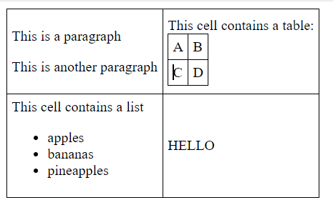
Example:

